Slide 1

CHANGING NATIONS
THE POPULATION SHIFT
Notes:
Begin by playing the attached PowerPoint, when you reach the second slide discuss with students what they think a Megacity might be.

Slide 2
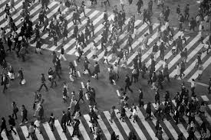
URBANISATION
The increase of the population density in Urban Areas.
As rural populations decrease more and more people are moving to cities.
Notes:
Read through and discuss.

Slide 3

MEGACITIES
THE WORLD IS CHANGING, MEGACITIES ARE ON THE RISE.
Notes:
Continue reading through the slides and engaging the students, it is suggested that students take brief do point notes of the slides.

Slide 4
WHAT IS A MEGACITY?
A megacity is a city with a population exceeding 10 million
There are currently 35 megacities in the World
80% of the worlds megacities are in Asia
Notes:
Continue reading through the slides and engaging the students, it is suggested that students take brief do point notes of the slides.

Slide 5
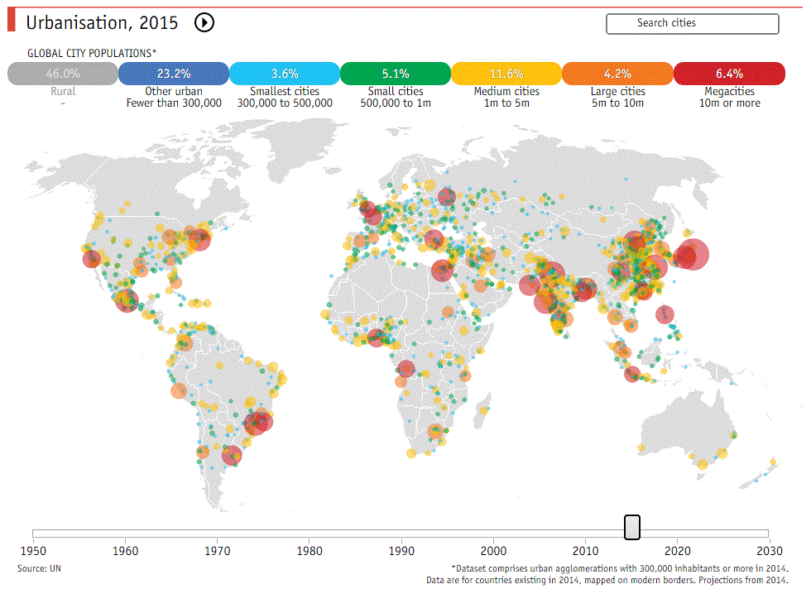
Notes:
Continue reading through the slides and engaging the students, it is suggested that students take brief do point notes of the slides.

Slide 6
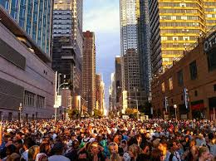
Populations
NEW YORK CITY, USA
MUMBAI, INDIA
SAU PAULO, BRAZIL
LAGOS, NIGERIA
MOSCOW, RUSSIA
PARIS, FRANCE

Slide 7
HOW DO YOU POSSIBLY MANAGE A CITY OF SO MANY PEOPLE?
CITIES ARE DIVIDED INTO 5 MAJOR AREAS
Notes:
Continue reading through the slides and engaging the students, it is suggested that students take brief do point notes of the slides.

Slide 8
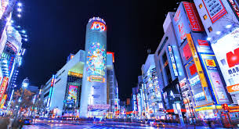
CENTRAL BUSINESS DISTRICT (CBD)
The central business district is usually the most established and accessible section of any city. The fierce competition for sparse land in these areas means the cost of real-estate is much higher in this part of the city.
Notes:
Continue reading through the slides and engaging the students, it is suggested that students take brief do point notes of the slides.

Slide 9
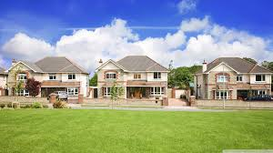
RESIDENTIAL AREAS
Residential areas account for the majority of land use in a city. The areas are used for accommodation but also services and facilities such as, schools & hospitals, for residents in the area.
Notes:
Continue reading through the slides and engaging the students, it is suggested that students take brief do point notes of the slides.

Slide 10
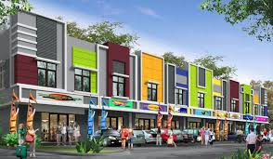
COMMERCIAL AREAS
Commercial areas of a city are generally located on very accessible road networks. Commercial areas are home to shopping centres, malls and businesses.
Notes:
Continue reading through the slides and engaging the students, it is suggested that students take brief do point notes of the slides.

Slide 11
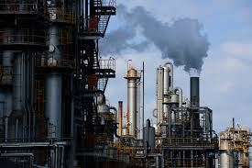
INDUSTRIAL AREAS
Industrial areas are usually located close major transport links such as rail lines, ports & freeways. They are home to factories, warehouses & mills. Industrial areas are located as far away from residential areas as they possibly can be.
Notes:
Continue reading through the slides and engaging the students, it is suggested that students take brief do point notes of the slides.

Slide 12
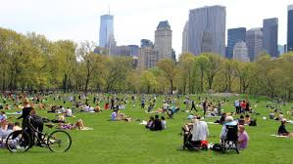
PARKLAND & NATURE AREAS
Parkland Areas in cities are essential in providing a appropriate area for recreational and sporting activities. They also maintain a healthy population of native plants and animals in the area.
Notes:
Continue reading through the slides and engaging the students, it is suggested that students take brief do point notes of the slides.

Slide 13
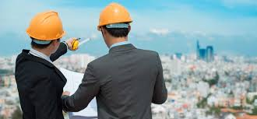
BUT WHAT IF THE CITY BECOMES TOO BIG
There are several techniques used by development planners too organize how cities will grow & accommodate for their growing populations.
Notes:
Continue reading through the slides and engaging the students, it is suggested that students take brief do point notes of the slides.

Slide 14
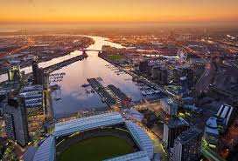
SUBURBANISATION
Developing new housing estates, further away from the Central Business District. As the name suggests this involves creating new suburbs on farmland or underused areas.
Docklands is an example of suburbanisation.
Notes:
Continue reading through the slides and engaging the students, it is suggested that students take brief do point notes of the slides.

Slide 15
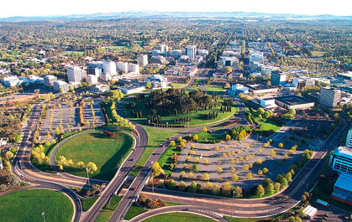
DECENTRALIZATION
Encouraging the growth of regional and suburban economies by introducing more career and entrepreneurial opportunities to such areas.
Canberra is an example of a decentralized City
Notes:
Continue reading through the slides and engaging the students, it is suggested that students take brief do point notes of the slides.

Slide 16
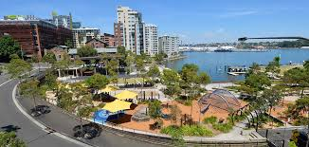
URBAN RENEWAL
Urban renewal is the process of redeveloping underused parts of a city to create new, modern buildings.
Pyrmont-Ultimo, Sydney is an example of a city which has undergone urban renewal
Notes:
Continue reading through the slides and engaging the students, it is suggested that students take brief do point notes of the slides.

Slide 17
Our megacity populations
NEW YORK CITY, USA
MUMBAI, INDIA
SAU PAULO, BRAZIL
LAGOS, NIGERIA
MOSCOW, RUSSIA
PARIS, FRANCE

Slide 18
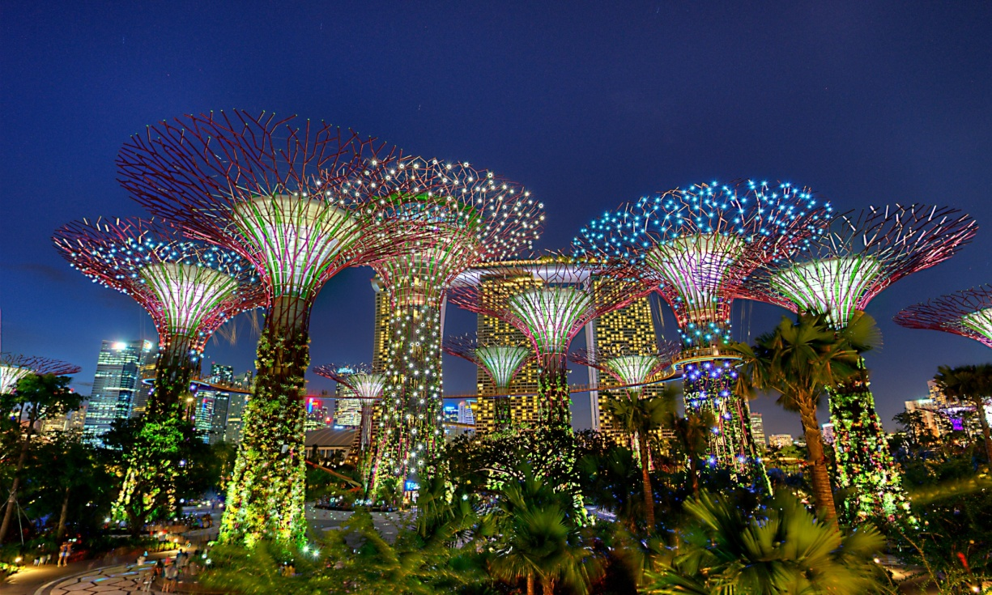
Singapore
Urban environment - with man made trees and conservatories

Slide 19
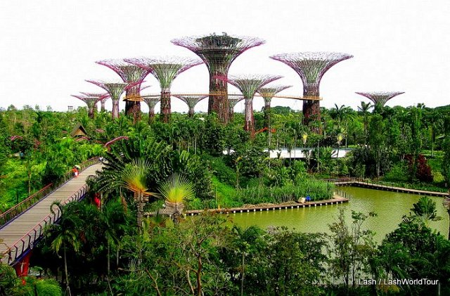

Slide 20
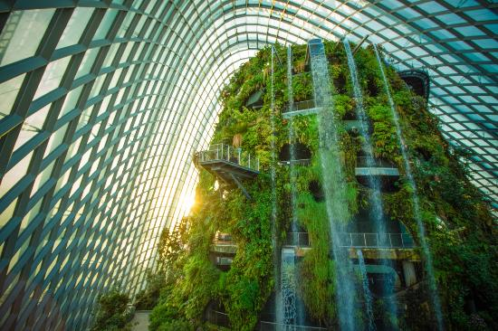
Singapore
Cloud forest

Slide 21
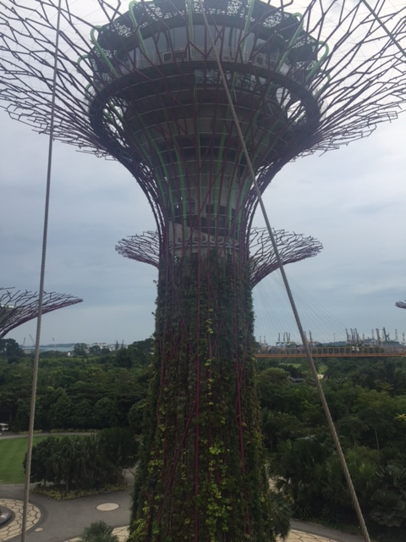
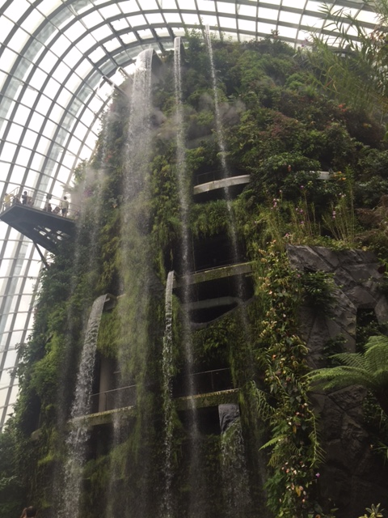

Slide 22
Urbanisation is:
The movement of people from rural areas to large cities.
This occurs because of push and pull factors

Slide 23
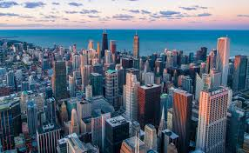
Push and pull factors
These can be economic, social, environmental or political
They are the reasons people move to urban areas

Slide 24
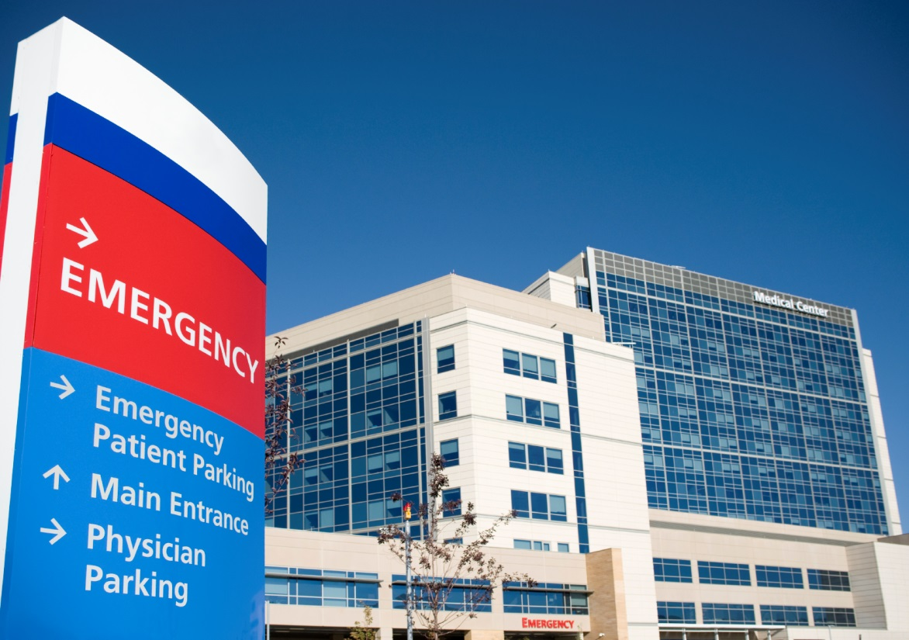
Pull factors
Employment opportunities
Promise of higher standards of living
Entertainment
Medical facilities
Educational opportunities

Slide 25
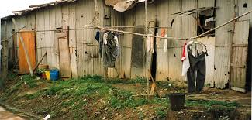
Push factors
Landlessness
War and civil disorder
Intolerance of alternate lifestyles
Desertification
Rapid population growth
Rural poverty
Lack of educational opportunity

Slide 26
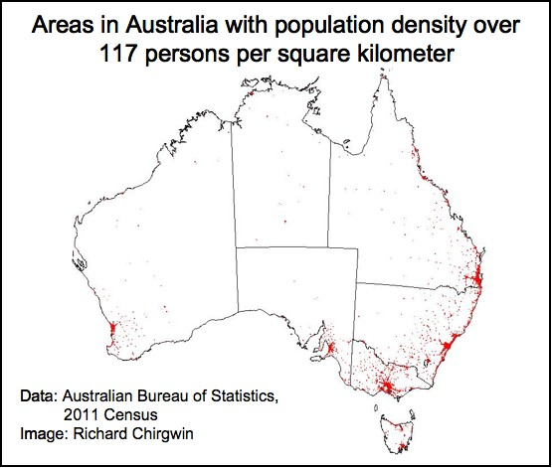
More developed countries
We see young people particularly in Australia move to the cities
This can have a severe effect on rural areas.

Slide 27
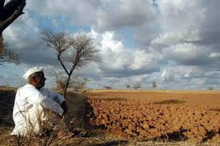
Less developed
In less developed countries it is usually young men who migrate to the cities
The elderly are often left in the countryside to look after the land

Slide 28
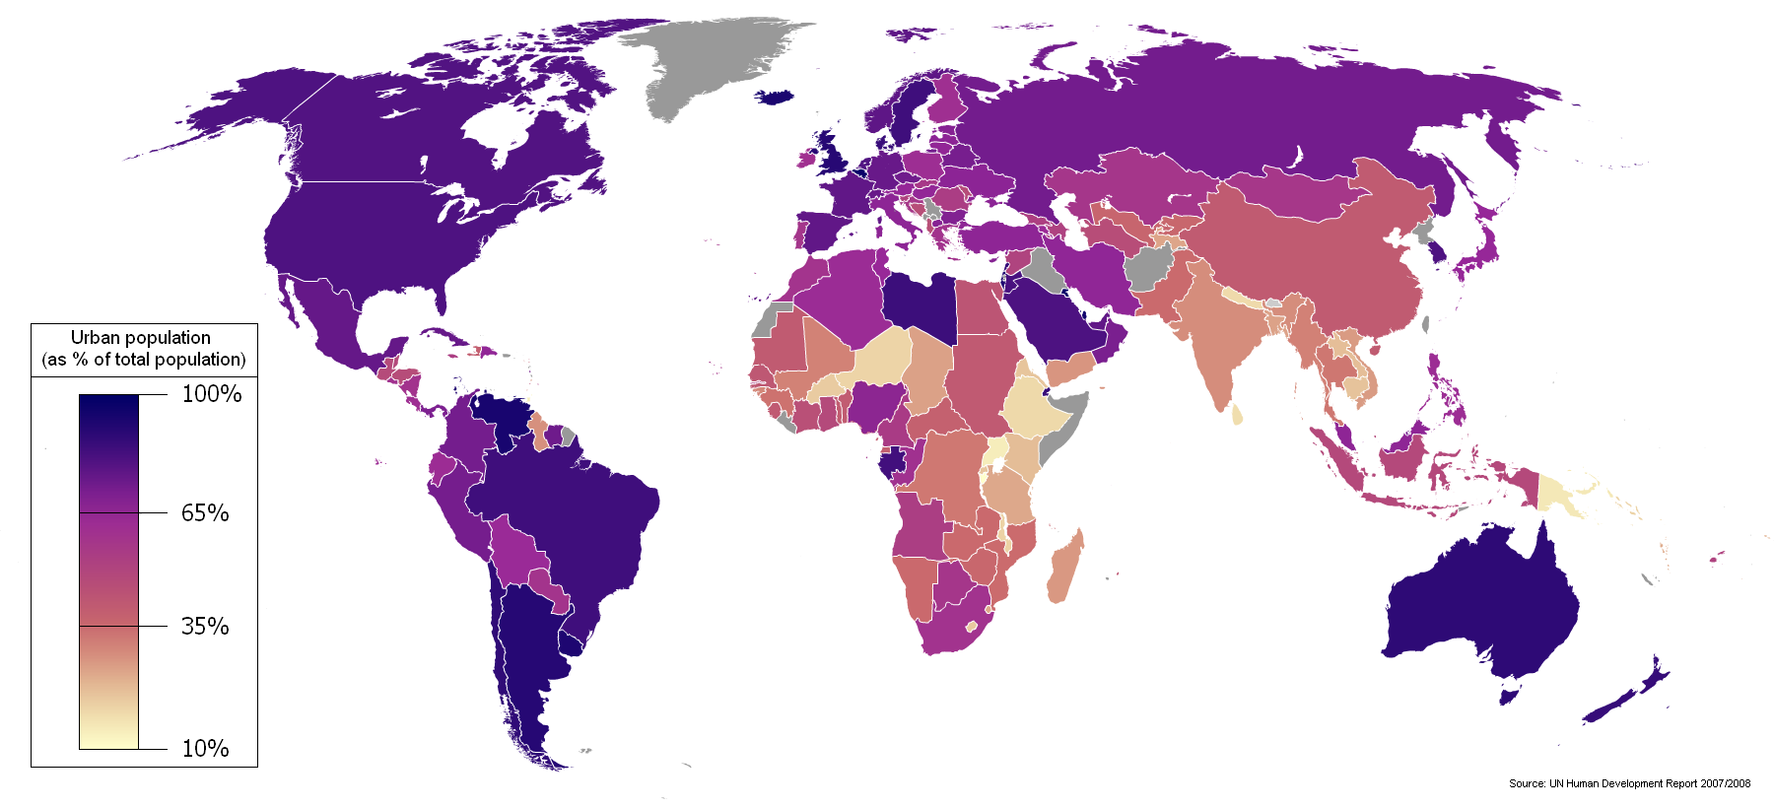

Slide 29
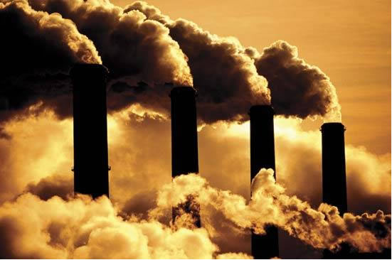
Environmental impacts
Carbon emissions increase – this creates the enhanced greenhouse effect – leads to global warming

Slide 30
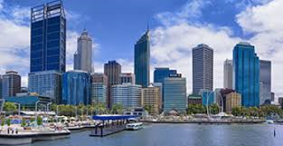
What would the climate be like in Perth without the city?
Would the climate be warmer or cooler?

Slide 31
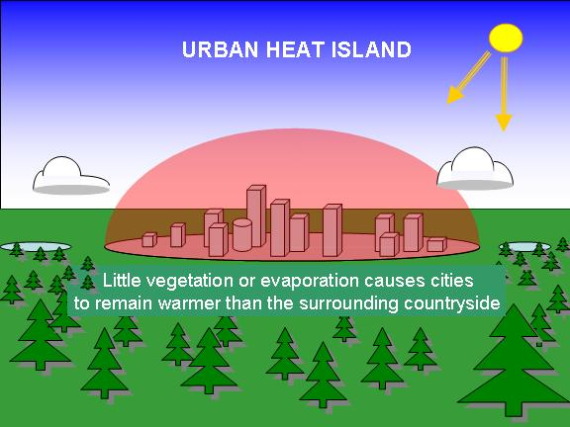
Environmental impacts
The urban island heat effect – cities absorb heat
Think about how white reflects heat – so lighter colours reflect
Cities have built up areas that absorb the heat, especially roads and then release the heat at night
There is less vegetation in cities, therefore less transpiration from plants, so less clouds form and we see less rainfall.

Slide 32

Water consumption
Cities use large amounts of water and produce large quantities of wastewater
As cities grow there is increased pressure on access to safe water, proper sanitation, stormwater and wastewater disposal.

Slide 33
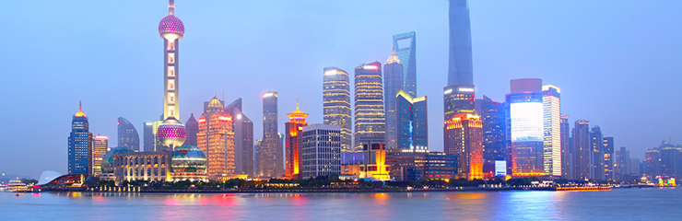
Urban growth in China https://youtu.be/KNXg-kYk-LU
What motivates rural people to move to cities in China?
What issues are faced by rural people living in big cities?
What statistics and dates are provided about population movement? Replay the video if necessary.
What are the benefits to the country from the growth of cities?
What are the major negative impacts of urban expansion?

Slide 34
Megacities
http://www.youtube.com/watch?v=GEP_W2BcjIM

